Slide 1

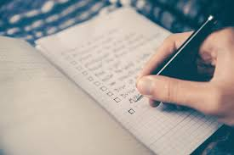

Card sort and Trigger Lists
Try to do small, consistent chunks of revision throughout the year instead of cramming everything in at the last minute.
David Smit
Completed A-Levels in 2018. Studying Social Psychology at Loughborough

Slide 2
What does Kinesthetic mean?

Slide 3
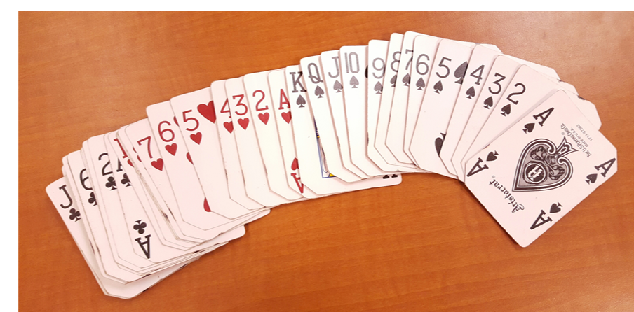
What is card sort?
A kinesthetic method of revision, because you physically move the information around.
You can organise a large number of cards into groups or categories
These cards can be used to create links between concepts
Or to develop concepts and models
Or to check what you can remember

Slide 4
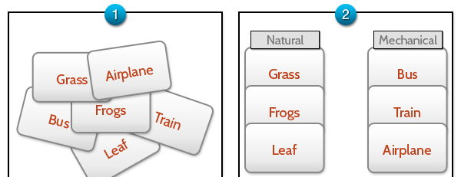
Sorting into groups

Slide 5
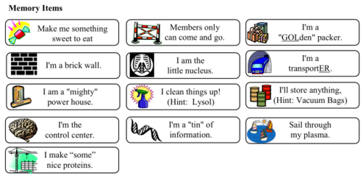
To organize ideas
The cards can be grouped or organised to model a complex system and show the links between different things.
They can be put into an order, going from most important to least.
Example: parts of a cell
What is each of these?
Which is most important? Why?

Slide 6
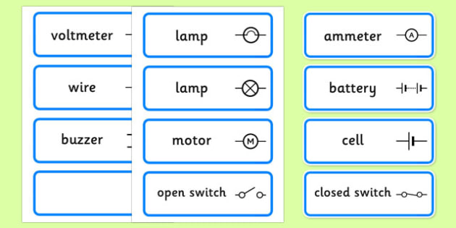
To make models
For example: Build a circuit by using these components.
Which card do you need more of?
Where does the voltmeter go in the circuit?

Slide 7
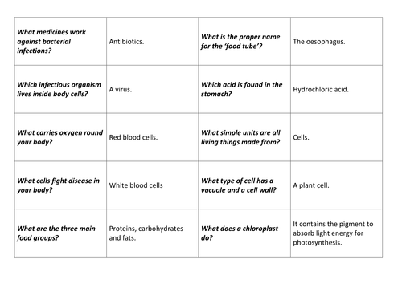
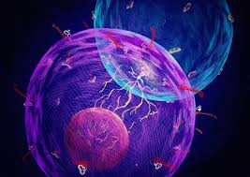
To check what you can remember

Slide 8
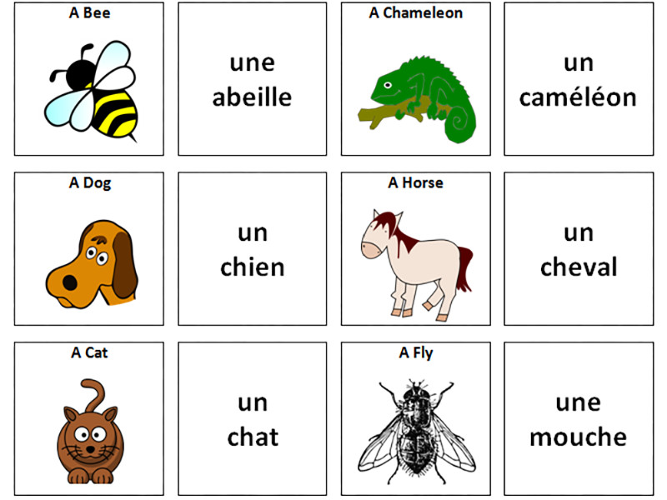
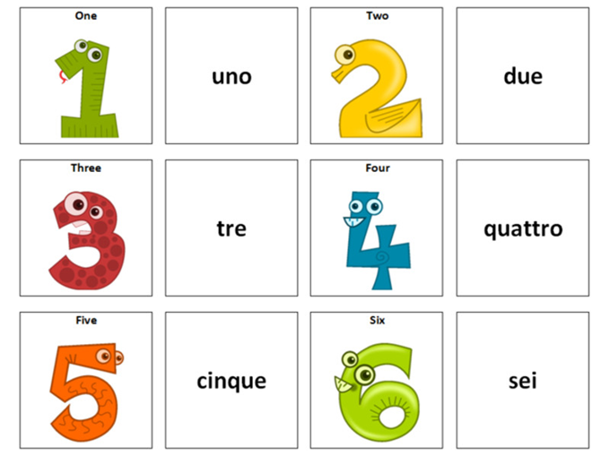

Slide 9
TASK
Create at least 14 cards on a topic you have studied.
For example, you may put a key word on one card and the definition on another or an equation on one card and what it means on another. You may choose to include images.
Mix these up, organise them. Once this becomes easy and you organise them correctly quickly, create and add more cards!
Competition: See who can make the most amount of cards and organise them correctly!

Slide 10

What is a trigger list?
Sometimes can be called a mental hook or a memory jogger.
It can be used to make connections between different ideas or lists to be able to remember them easily.
It can be a series of pictures.
Very good as a short cut to learning large amounts of information.
PEEL
Point Evidence Explanation Link
Used in which subject?

Slide 11
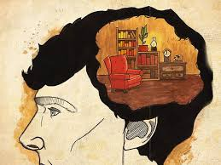
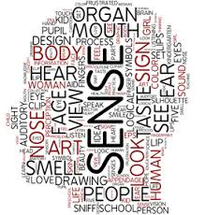


How we remember things…….
Our memory works by building links.
We remember things which are associated in our mind by repetition,
  sense
  colour
  rhythm, rhyme
  anything which is unique or unusual.
What did you see in the last slide?

Slide 12
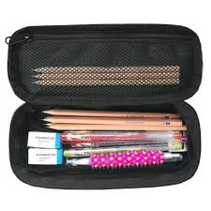
Mnemonics work in a similar way…
Spelling mnemonics:
Accommodation: Two cots need two mattresses in any accommodation.
Stationery is paper. Stationary is a parked car.
Necessary: It is necessary to have one collar and two sleeves.
Practise (is is a verb) and practice (ice is a noun)

Slide 13
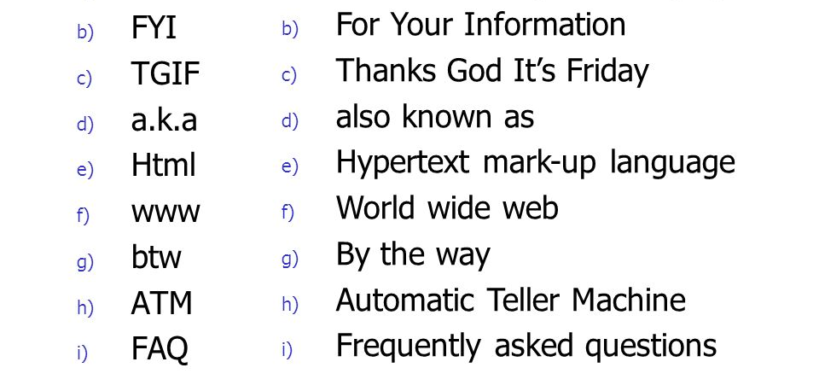
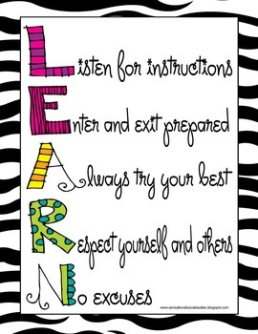
Acronyms can also be helpful, you already know some…

Slide 14
What do these letters stand for?
ROYGBIV
Richard
Of
York
Gave
Battle
In
Vain
Never Eat Shredded Wheat

Slide 15


Rainbow or Spectrum and compass

Slide 16
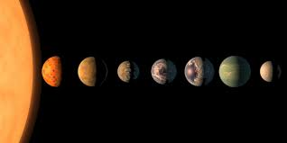
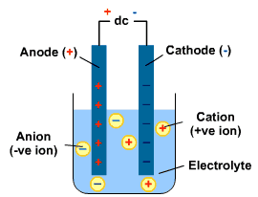
Subject specific acronyms
OIL oxidation is the loss of electrons
RIG reduction is the gain of electrons in Electrolysis
Solar System Planets
My MERCURY
Very VENUS
Eager EARTH
Mother MARS
Just JUPITER
Served SATURN
Up URANUS
Nine NEPTUNE
Pizzas PLUTO

Slide 17
TASK
Can you come up with an acronym for something in your subject?
Who can come up with the best acronym that enables you to remember those most amount of information?

