Slide 1
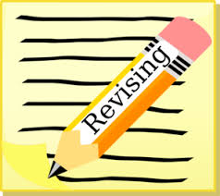
REVISION STRATEGIES
VISUAL LEARNING:
One way to revise is using graphical diagrams or charts to represent what you have been studying.
I think revising from the get go is essential. I know this might sound boring but taking just half hour/hour to go over that day's lessons, rewriting the notes helps you to stay organised, on track and actually helps a lot with later stages when it comes to revision.
Rene Pupala
Completed A-Levels in 2018
Planning to Study Computer Science and Mathematics at Loughborough University, with an industry placement year.

Slide 2
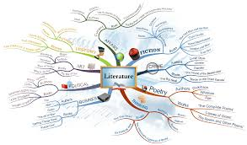
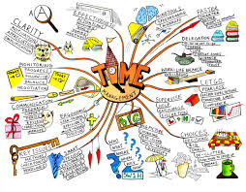
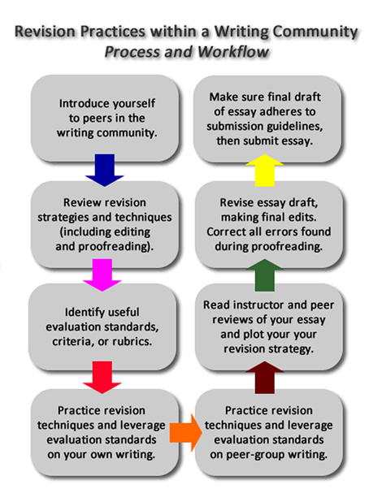
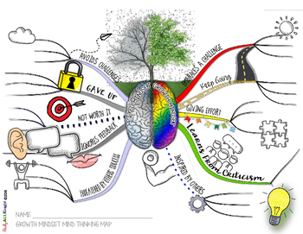
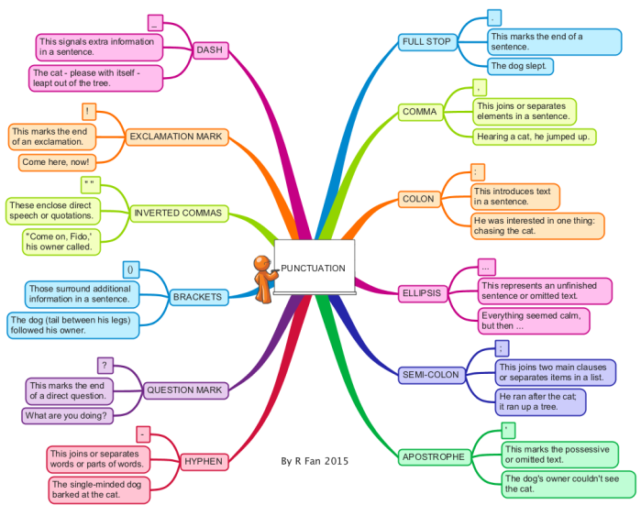
Mind maps/Flow charts

Slide 3
Why should we use mind maps?
A mind map is a diagram which represents all the information you need to revise in a visual manner.
It enables you to get to grips with a large body of information, increase memory retention during the revision process and even boost your creativity.

Slide 4
Step 1:
Take your anthology to revise.
Create a new mind map with only the main topic branches.
‘I break down large bits of information into relevant points and colour code them based on the topic they come under’.
Zubaida Zahid
Completed A-Levels in 2018
Studying Counselling at university

Slide 5
It could look like this:

Slide 6
Or even like this:

Slide 7
Or like this:

Slide 8
Step 2:
Fill in the main topic areas.
Then see how much you can extend the branches from memory.

Slide 9
Step 3:
Where are the gaps?
This is when you need to return to your revision source and add the additional information.
You can now extend the branches further.

Slide 10
You can add:
Keywords
Colours
Images / diagrams
to link all the ideas / topics.

Slide 11
Why could you use flow charts for revision?
A flowchart is a type of diagram that represents a process .
The flowchart shows the steps as boxes of various kinds, and their order by connecting the boxes with arrows.
This visual revision tool is useful for those subjects where processing or sequencing are a key part of study.

Slide 13
What visual resource will you use to help with your revision?
‘Always keep your notes organised (ideally in a file), focus on the things you don't know as well, find a quiet place to revise without any distractions and take small breaks in between and reward yourself’.
Harriet Antrobus, Year 13
Studying Psychology, Biology and English Literature

