Slide 1
A song comes on the radio you haven’t heard in months, possibly even years… can you remember the words?
Has this happened to you?
https://www.youtube.com/watch?v=3qHA366oRMs&safe=true
Notes:
Play clip and see who knows the words.
Ask if they have only heard the song once in order to know the words
RISK- year 7s may not know the song (they might) if not, ask them a song that many of them know the words to

Slide 2
How do you know the words?
Have you only heard it once?
Or have you heard it many times?
Have you sung the words several times?
What is revision?

Slide 3
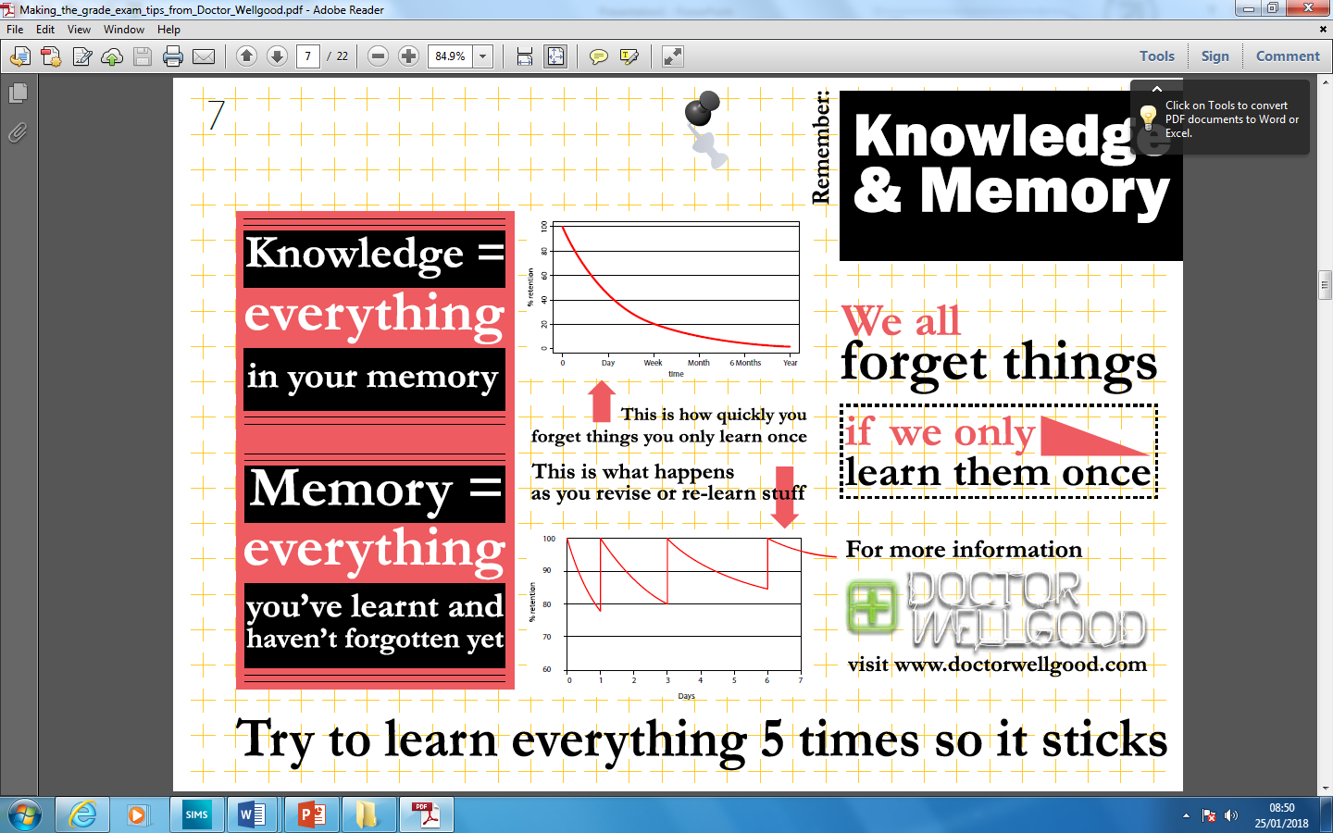
‘No matter how smart you are, people who revise are going to know more than you’
Ehsan Farrakh, Year 13

Slide 6
What different methods of revision do you know of?
Notes:
Brainstorm, hand down questioning, think/pair/ share

Slide 7
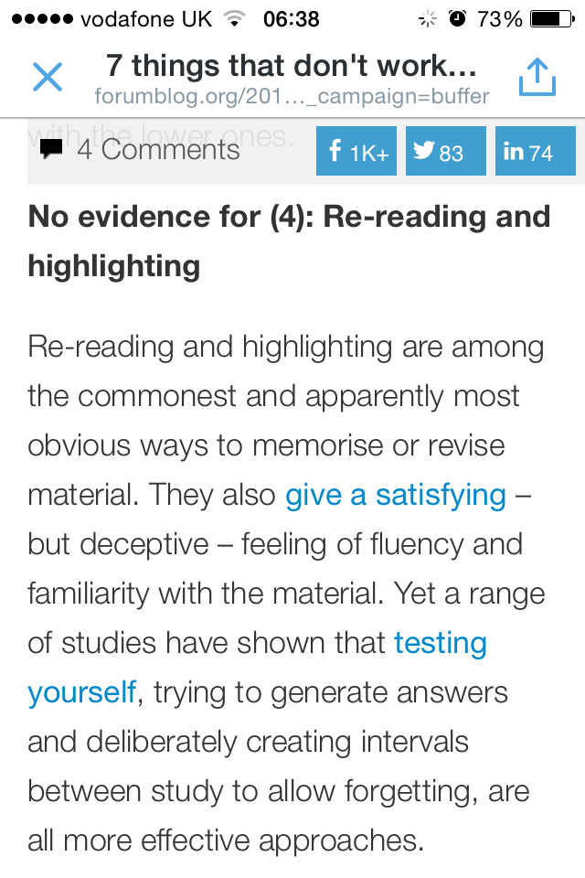
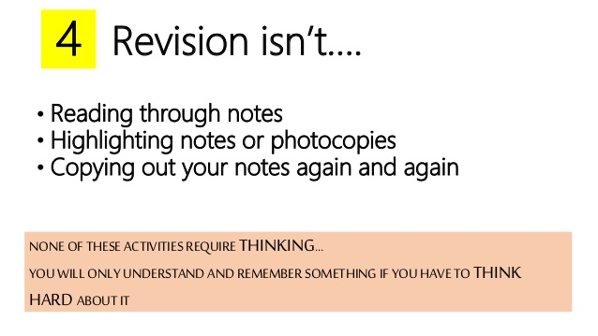

Slide 8
How Will Revision Day Work?
You will attend all your normal timetabled lessons.
In each lesson you will learn about a different revision technique and put it in to practice.
You will keep all revision resources and information from revision day in a revision folder that you will get during morning registration.
You will still need to bring your school bag, books and equipment with you as these will be used in lessons too.
WHY ARE WE DOING THIS?
This day will help you on your journey to success!
It will help you prepare for tests, assessments and exams, whether you are in year 7 or 13. It will support your well being when it comes to revision and making the best possible progress.

