Slide 1

Revise everything on this page for 30 seconds and then share what you can remember…

Slide 2
How much can you remember?

Slide 3

Re-reading your work, notes or a book does not allow you to learn the information. It only allows you to recognise what you read.
Which will not help you in assessment or exam situations.
How could you learn the information from the first slide?

Slide 4
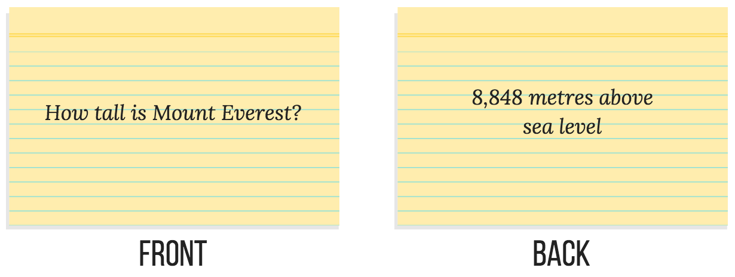
Flashcards are sets of small, double-sided cards used to learn and revise details, keywords and vocabulary. They are useful for learning the relationship between two pieces of information. You write a question or key term on the front and then the answer or definition on the back.
‘Create flashcards by cutting paper into squares and write a trigger word on one side and a description on the other and add a picture/diagram if you can to help visualise the information’. Next year I am going into year 13. I hope to continue with sociology, psychology and photography. After A levels I am looking at attending Lancaster University to study criminology so I can later become a criminal counsellor. To help achieve this I am completing a work placement at Mount prison with sniffer dogs’.
Heidi Green, Year 13

Slide 5
Lets choose an area from the information below and make a flash card as a class. What makes it a good flashcard?
Clues
How much on each card?
Does it all have to be words?
Success Criteria

Slide 6

Using the class example as a template, now make a series of cue cards on a) the topic area given b) another area (within the same subject), using your exercise book, textbook or resource/s given
IT DOES NOT MATTER IF YOUR CUE CARDS LOOK DIFFERENT TO SOMEONE ELSE’S!
Clues
How much on each card?
Does it all have to be words?
Success Criteria
What word, equation, fact, concept etc. do you find really difficult to remember, how could you make this stand out?
This can be personal to you, it is your revision.

Slide 7
How Could You Use These To Test Yourself?

Slide 8

Test Yourself

Slide 9
How could you revise using these cards in pairs?
Test each other

Slide 10
Competition
Impress your partner- tell them everything you can remember about the particular area you revised
OR
How much information can you remember? Write down as much as possible…

